Slide 1
Nick’s Review topics
Packet Switching
Routing, spanning trees and Dijkstra

Slide 2
CS144: An Introduction to Computer Networks
Packet Switching

Slide 3
Outline
End-to-end delay
Queueing delay
Simple deterministic queue model
Rate guarantees
Delay guarantees

Slide 4

Propagation Delay, t_{l}: The time it takes a single bit to travel over a link at propagation speed c.
l
Example: A bit takes 5ms to travel 1,000km in an optical fiber with propagation speed 2 x 10⁸ m/s.

Slide 5
Packetization Delay, t_{p}: The time from when the first to the last bit of a packet is transmitted.
p
r bits/s
Example 1: A 64byte packet takes 5.12μs to be transmitted onto a 100Mb/s link.
Example 2: A 1kbit packet takes 1.024s to be transmitted onto a 1kb/s link.

Slide 6
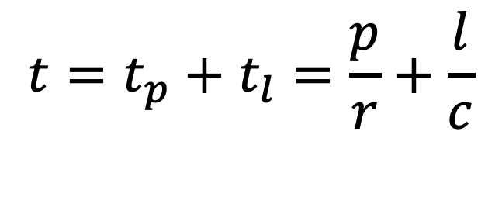
Total time to send a packet across a link: The time from when the first bit is transmitted until the last bit arrives.
l
p
r bits/s
$$t=t_{p}+t_{l}=\frac{p}{r}+\frac{l}{c}$$
Example: A 100bit packet takes 10 + 5 = 15μs to be sent at 10Mb/s over a 1km link.

Slide 7
Simple model of a router queue

Slide 8
Simple model of a queue
A(t)
A(t): Cumulative Arrivals. Non-decreasing.
D(t): Cumulative Departures. Non-decreasing.
Queue occupancy: Q(t) = A(t) - D(t).
Queueing delay, d(t), is the time spent in the queue by a byte that arrived at time t, assuming the queue is served first-come-first-served (FCFS).
D(t)
Cumulative
number of bytes
d(t)
Q(t)
Time

Slide 9
Example (store & forward)
Every second, a 500 bit packet arrives to a queue at rate 10,000b/s. The maximum departure rate is 1,000b/s. What is the average occupancy of the queue?
Cumulative
number of bits
A(t)
500
D(t)
Q(t)
0.05s
0.55s
1.0s
1.05s
time
Solution: During each repeating 1s cycle, the queue fills at rate 10,000b/s for 0.05s, then empties at rate 1,000b/s for 0.5s. Over the first 0.55s, the average queue occupancy is therefore 250 bits. The queue is empty for 0.45s every cycle, and so average queue occupancy is (0.55 * 250) + (0.45 * 0) = 137.5 bits.
Notes:
See worked example video for more details…

Slide 10
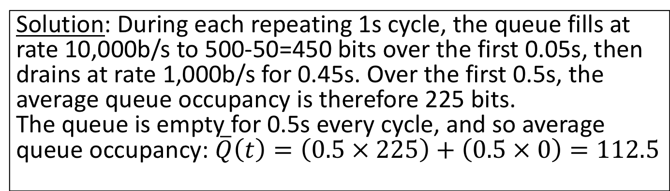
Example (“cut through”)
Cumulative
number of bits
Every second, a 500 bit packet arrives to a queue at rate 10,000b/s. The maximum departure rate is 1,000b/s. What is the time average occupancy of the queue?
A(t)
500
D(t)
Q(t)
0.05s
0.5s
1.0s
time
Solution: During each repeating 1s cycle, the queue fills at rate 10,000b/s to 500-50=450 bits over the first 0.05s, then drains at rate 1,000b/s for 0.45s. Over the first 0.5s, the average queue occupancy is therefore 225 bits.
The queue is empty for 0.5s every cycle, and so average queue occupancy: $\overline{Q}\left(t\right)=\left(0.5 × 225\right)+\left(0.5 × 0\right)=112.5$
Notes:
See worked example video for more details…

Slide 11
How do I give flows a weighted fair share of a link? (instead of strict priority)
Notes:
So how can a packet switched network give weighted priorities between two or more flows, instead of just strict priority?

Slide 12
Weighted Fair Queueing
3
2
1
3/4
3
2
2
1
1
6
5
4
3
2
1
3
2
2
1
1
1/4
As before, packets are sent in the order they would complete in the bit-by-bit scheme.
Notes:
This variant is called Weighted Fair Queueing and is one of the most famous results in the field of packet switching.
IN this example, we want to give ¾ of the outgoing link to the blue flow and ¼ to the red flow. We want the traffic in the upper blue queue to be served at THREE TIMES the rate of the traffic in the lower queue. The same result works as before. We first pretend to schedule the packets bit by bit, taking three blue bits for every one red bit. Then we figure out the order in which the packets would complete, shown here. And we send the packets in this order. Notice that the blue packets are sent more often now, because they complete sooner.
We can generalize Weighted Fair Queueing to the situation where there are “n” queues, each with their own rate……

Slide 13
Weighted Fair Queueing (WFQ)
It can be proved that the departure time of a packet with WFQ is no more than L_{max}/R seconds later than if it was scheduled bit-by-bit. Where L_{max} is the maximum length packet and R is the data rate of the outgoing link.
In the limit, flows receive their weighted fair share of the link.
Notes:
The answer is Yes – Fair queueing gives equal share bit rate to both.
In fact, It can be proved that the departure time of a packet with Fair Queueing is no more than L_{max}/R seconds later than if it was scheduled bit-by-bit. Where L_{max} is the maximum length packet and R is the data rate of the outgoing link.
This means that in the limit, the two flows receive equal share of the data rate.
The result extends to any number of flows sharing a link. If you’d like to learn more about Fair Queueing, and read the main proof that it works, then you can find this paper on the web.
Now we know how to give an equal fair share to flows, what if we want to give an unequal fair share?

Slide 14
Weighted Fair Queueing (WFQ)
𝜙₁
Packets arriving at different ingress ports
𝜙_{i}
Classify packets into flows
Packet scheduler
R
∑𝜙_{i} = 1
𝜙_{N}
_{i}
Flow i is guaranteed to receive at least rate
𝜙_{i}R
Notes:
Putting it all together, here is what a switch needs to do in order to implement WFQ for N flows sharing a link of rate R.
When packets arrive at different ingress ports, the switch needs to classify which flow the packet belongs to <click>. This is the first pink box on the left. It then puts the packet in the correct flow queue <click>.
The packet scheduler on the right pulls packets from the heads of the flow queues using the scheme I described earlier <click>. It figures out which packet will finish next if they were served bit by bit.
As I’m sure you can see, WFQ is very powerful. It’s conceptually simple and lets us give a guaranteed bit rate to every flow, even though the packets are variable size.
In case you are worrying about how complicated the packet scheduler’s job is, and whether it can really be made practical, there are lots of papers describing clever techniques to build it. The original WFQ paper also explains how we can determine the finishing time of a packet when it first arrives, making the job much simpler. WFQ schedules have been built at very high speeds, and most commercial switches and routers today implement it, or something very close to it, in order to give a weighted fair share of the link.

Slide 15
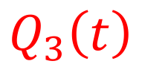
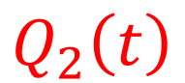
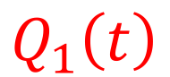
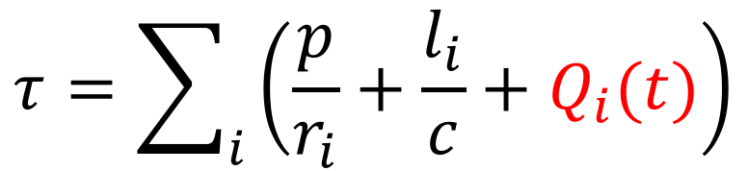
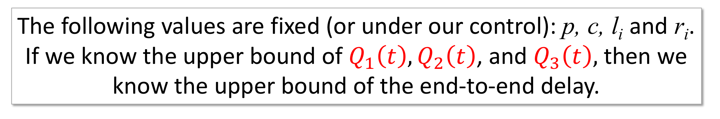
Delay guarantees: Intuition
A
l₁, r₁
l₂, r₂
l₃, r₃
l₄, r₄
B
$$Q_{1}\left(t\right)$$
$$Q_{2}\left(t\right)$$
$$Q_{3}\left(t\right)$$
$$τ=\sum_{i}{\left(\frac{p}{r_{i}}+\frac{l_{i}}{c}+Q_{i}(t)\right)}$$
End-to-end delay,
The following values are fixed (or under our control): p, c, l_{i} and r_{i}.
If we know the upper bound of $Q_{1}\left(t\right), Q_{2}\left(t\right)$, and $Q_{3}\left(t\right),$ then we know the upper bound of the end-to-end delay.
Notes:
I'm going to start by giving you the intuition for how it works. Here is our network of packet switches again, from an earlier video. End Host A sends packet to End Host B over 4 links and through three packet switches. You’ll remember the equation for the end to end delay,
Tau equals the sum of the packetization delay p over r I, the propagation delay L I over c and the queueing delay…. across the network.
The only variable portion of the delay is the queueing delay in each switch, caused by other flows sharing the queues with our packets. And so if we want to guarantee an upper bound on the delay across the network, we need to bound the queueing delay in each swtich.
The intuition behind it is as follows: The following value are fixed (or under our control): p, c, l_{i} and r_{i}.
If we know the upper bound of $Q_{1}\left(t\right), Q_{2}\left(t\right)$, and $Q_{3}\left(t\right),$ then we know the upper bound of the end-to-end delay.
We are going to use the fact that we can guarantee the rate of a flow to bound the queueing delay it experiences in each packet switch along the way.

Slide 16
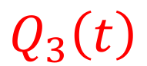
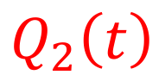
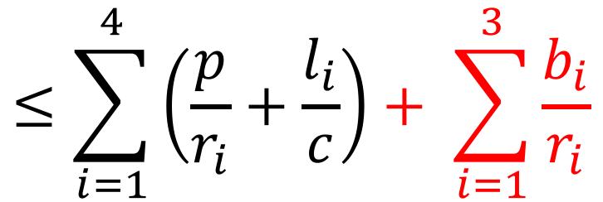
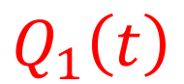
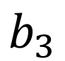
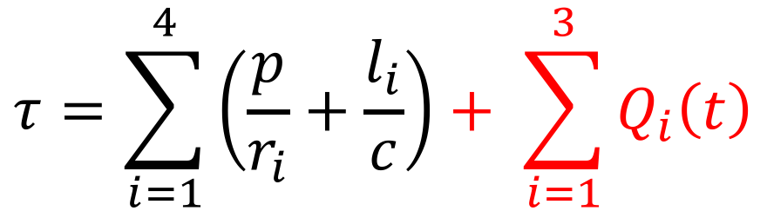
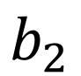
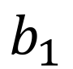
Delay guarantees: Intuition
$$b_{1}$$
$$b_{2}$$
$$b_{3}$$
A
l₁, r₁
l₂, r₂
l₃, r₃
l₄, r₄
B
$$Q_{1}\left(t\right)$$
$$Q_{2}\left(t\right)$$
$$Q_{3}\left(t\right)$$
$$τ=\sum_{i=1}^{4}{\left(\frac{p}{r_{i}}+\frac{l_{i}}{c}\right)+ \sum_{i=1}^{3}{Q_{i}\left(t\right)}}$$
End-to-end delay for a single packet,
$$≤\sum_{i=1}^{4}{\left(\frac{p}{r_{i}}+\frac{l_{i}}{c}\right)+ \sum_{i=1}^{3}{\frac{b_{i}}{r_{i}}}}$$
Notes:
This is easily extended to a packet passing through a network of switches, where we know the size of each queue and the rate at which it is served.
In this example, imagine a network that is completely idle, with no other packets in it. We send a sequence of packets from A to B along exactly the same path, through the same queues shown here.
Our single packet will have an end to end delay bounded by this formula: The sum of the fixed delay over four links, plus the upper bound on how long it takes to go through the three router queues of size b1, b2 and b3.

Slide 17
Bounding end-to-end delay
Allocate a queue of size b for this flow
Assign a WFQ service rate of𝜙R
b
b
𝜙R
𝜙R
l
l
l
l
b
𝜙R
The end-to-end delay of a single packet of length p $≤4\left(\frac{l}{c}+\frac{p}{R}\right)+3\frac{b}{\text{φ}\text{R} }$
Notes:
First we can allocate a queue of size b in each of the routers along the path, served at rate fai times R using WFQ. This gives us a simple expression for the end to end delay for packets belonging to the flow. No matter what other traffic is in the network, so long as this queue is served at rate fai times R, then the end to end delay is bounded.

Slide 18
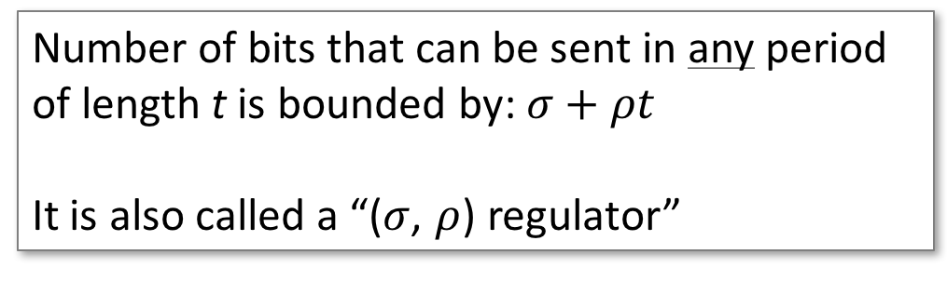

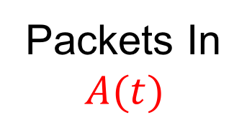
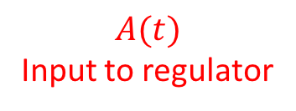

The leaky bucket regulator
ρ
$$A(t)$$
Input to regulator
ρ
Cumulative
bits
σ
σ
Packets In
$$A(t)$$
Packets Out
$$D(t)$$
$$D(t)$$
Output from regulator
Number of bits that can be sent in any period of length t is bounded by: $σ+ρt$
It is also called a “($σ$, $ρ$) regulator”
time
Notes:
Put more precisely, the leaky bucket regulator makes sure that the number of bits that can be sent in any period of length t is bounded by: $σ+ρt$
Another name for a leaky bucket regulator is a "sigma rho regulator" for this reason, and by convention we use rho to refer to the long term rate and sigma the maximum size of a burst.
Let’s look at what a sigma rho regulator does to an arrival process, A(t) shown here <click>. Let’s assume this is the cumulative arrival of bits to the regulator over time. We can represent the sigma rho regulator by a blue line like this, starting at any point in time. Starting from any point in time, the regulator will constrain the output process to fall below the blue line, because it won't allow an instantaneous burst of more than sigma and a long-term rate of more than rho. <click> In green is the output from the regulator, showing how red arrivals are delayed in the regulator until they can depart. And now we have placed a bound on how bursty the output is from the regulator.

Slide 19
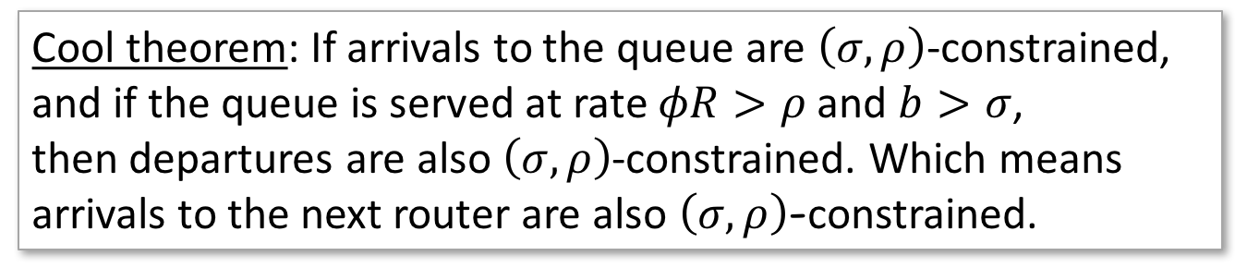
The leaky bucket regulator Limiting the “burstiness”
ρ
Cool theorem: If arrivals to the queue are $\left(σ,ρ\right)$-constrained,
and if the queue is served at rate $φR>ρ$ and $b>σ$,
then departures are also $\left(σ,ρ\right)$-constrained. Which means
arrivals to the next router are also $\left(σ,ρ\right)$-constrained.
σ
b
b
𝜙R
𝜙R
If $φR>ρ$ and $b>σ$ then delay through the first router for all packets in the flow $≤\frac{b}{\text{φ}\text{R} }$
Notes:
Let's see how we use the leaky bucket regulator in practice. The end host contains a leaky bucket regulator, implemented in software or in hardware. It guarantees that the packets the host is sending into the network are sigma-rho constrained. If the buffer at the first router can hold up to b bits, then we need to make sure the packets leaving the end host are sufficiently regulated that they can't make the buffer overflow. This means the rate at which the buffer is served, fai times R, must be faster than the rate at which the end host sends bits into the network. In other words, we need fair times R greater than rho. If we also make b greater than sigma, then we can be sure the buffer can absorb the largest burst the end host will send. And if we make sure both of these properties are true, then we can be sure no packets are dropped and the delay through the first router is no more than b over fai times R seconds.
<click> What happens when the packets from the first router reach the second router along the path? Can we be sure the packets won't become bursty again, and overflow the second router?
Yes, we can be sure. <click> THere is a very cool theorem that says: If arrivals to the queue are $\left(σ,ρ\right)$-constrained,
and if the queue is served at rate $φR>ρ$ and $b>σ$,
then the departures from the router are also $\left(σ,ρ\right)$-constrained. Which means
arrivals to the next router are also $\left(σ,ρ\right)$-constrained too.
And so the delay through the second router is also guaranteed to be less than b over fai times R as well!

Slide 20
Putting it all together
ρ
σ
b
b
l
𝜙R
𝜙R
l
l
b
l
𝜙R
If $φR>ρ$ and $b>σ$ then the end-to-end delay of every packet of length p $≤4\left(\frac{l}{c}+\frac{p}{R}\right)+3\frac{b}{\text{φ}\text{R} }$
Notes:
Let’s put it all together.
If the end host has a leaky bucket regulator, and if every router uses Weighted Fair Queueing, then we can guarantee an upper bound on the end to end delay as follows:
<click> If $φR>ρ$ and $b>σ$ then the end-to-end delay of every packet of length p $≤4\left(\frac{l}{c}+\frac{p}{R}\right)+3\frac{b}{\text{φ}\text{R} }$

Slide 21
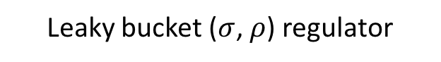
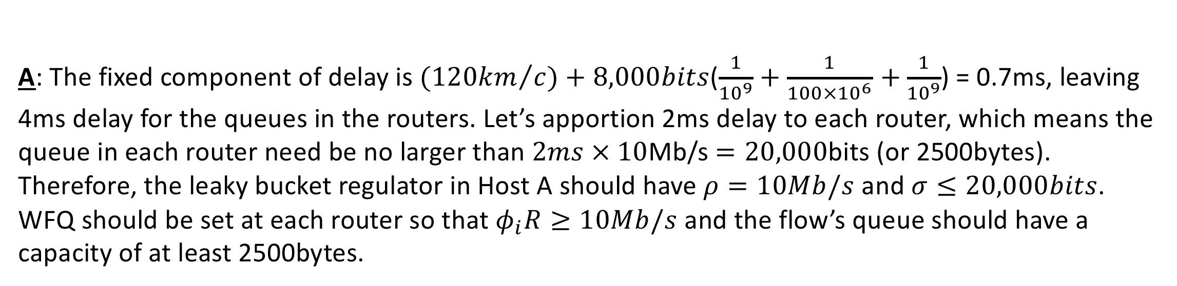
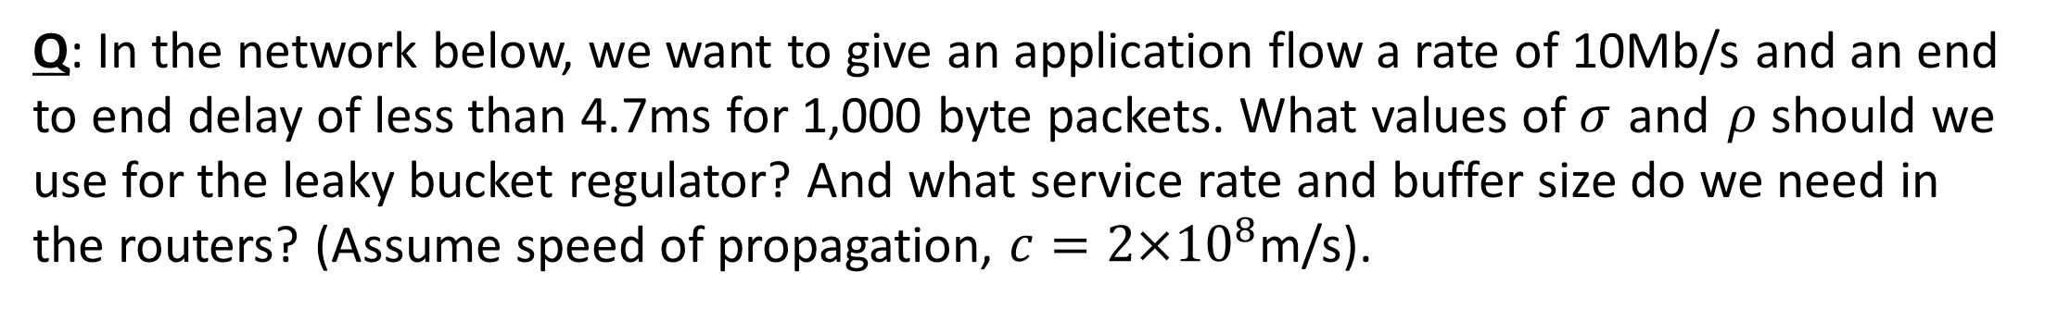
An Example
Q: In the network below, we want to give an application flow a rate of 10Mb/s and an end to end delay of less than 4.7ms for 1,000 byte packets. What values of $σ$ and $ρ$ should we use for the leaky bucket regulator? And what service rate and buffer size do we need in the routers? (Assume speed of propagation, $c=2{×10}^{8}$m/s).
Leaky bucket ($σ$, $ρ$) regulator
A
10km, 1Gb/s
100km, 100Mb/s
10km, 1Gb/s
B
A: The fixed component of delay is ${(120km}/c)+8,000bits$($\frac{1}{{10}^{9}}+\frac{1}{{100×10}^{6}}$ $+\frac{1}{{10}^{9}}$) = 0.7ms, leaving 4ms delay for the queues in the routers. Let’s apportion 2ms delay to each router, which means the queue in each router need be no larger than $2ms × 10$Mb/s $=20,000$bits (or 2500bytes). Therefore, the leaky bucket regulator in Host A should have $ρ=10Mb/s$ and $σ≤20,000bits$. WFQ should be set at each router so that $φ_{i}R≥10Mb/s$ and the flow’s queue should have a capacity of at least 2500bytes.
Notes:
Let’s look at a numeric example.
In the network below, we want to give an application flow a rate of 10Mb/s and an end to end delay of less than 4.7ms for 1,000 byte packets. What values of $σ$ and $ρ$ should we use for the leaky bucket regulator? And what service rate and buffer size do we need in the routers? We are going to assume a speed of propagation, $c=2{×10}^{8}$m/s.
Here is the answer:
The fixed component of delay – in other words, all of the delay except for the queueing delay – is given by ${(120km}/c)+8,000bits$($\frac{1}{{10}^{9}}+\frac{1}{{100×10}^{6}}$ $+\frac{1}{{10}^{9}}$) = 0.7ms. This leaves 4ms delay for the queues in the routers. We can apportion the delay between the routers however we want, so long as we can make the numbers work. Let’s make it simple and apportion 2ms delay to each router, which means the queue in each router should be no larger than $2ms × 10$Mb/s $=20,000$bits (or 2.5Kbytes). Therefore, the leaky bucket regulator in Host A should have $ρ=10Mb/s$ and $σ≤20,000bits$. WFQ should be set at each router so that $φ_{i}R≥10Mb/s$ and the flow’s queue should have a capacity of at least 2.5Kbytes.
If any part of the example doesn’t make sense, go back through the video and hopefully it will become clear.

Slide 22
Nick’s Review topics
Packet Switching
Routing, spanning trees and Dijkstra

Slide 23
Spanning Tree
A
B
C
D
R₁
R₂
R₄
R₆
R₇
R₅
R₃
R₈
X
Spanning tree
Spanning: It reaches all leaves
Tree: It has no loops

Slide 24
Dijkstra’s shortest path first algorithm (example of a “Link State Algorithm”)
Exchange link state: A router floods to every other router the state of links connected to it.
Periodically
When link state changes
Run Dijkstra: Each router independently runs Dijkstra’s shortest path first algorithm.
Each router finds min-cost spanning tree to every other router.

Slide 25
Example Annotated Graph
A
B
C
D
R₁
1
R₂
1
R₄
4
R₆
2
2
3
5
3
2
R₇
3
R₅
2
R₃
4
R₈
X

Slide 26
Example Annotated Graph
A
B
C
D
R₁
1
R₂
1
R₄
4
R₆
2
2
3
5
2
2
R₇
3
R₅
2
R₃
4
R₈
X
Minimum cost spanning tree. In this case, simple.

Slide 27
An example: spanning tree rooted on R₈
R₁
1
R₂
4
R₄
4
R₆
4
1
1
5
2
2
R₇
1
R₅
6
R₃
4
R₈

Slide 28
The algorithm
R₁
1
R₂
4
R₄
4
R₆
4
1
1
5
2
2
R₇
1
R₅
6
R₃
4
R₈
 | 0 | 1 | 2 | 3 | 4 | 5 | 6 | 7
Shortest Path Set | R₈
Candidate Set | R₃R₅ R₆R₇
Add | R₇

Slide 29
The algorithm
R₁
1
R₂
4
R₄
4
R₆
4
1
1
5
2
2
R₇
1
R₅
6
R₃
4
R₈
 | 0 | 1 | 2 | 3 | 4 | 5 | 6 | 7
Shortest Path Set | R₈ | R₈R₇ | R₈R₇ R₆ | R₈R₇ R₆R₄ | R₈R₇R₆ R₄R₃ | R₈R₇R₆ R₄R₃R₂ | R₈R₇R₆ R₄R₃R₂R₁ | R₈R₇R₆R₄R₃R₂R₁R₅
Candidate Set | R₃R₅ R₆R₇ | R₃R₅ R₆R₄ | R₃R₅ R₄ | R₃R₅ R₂ | R₅R₂ R₁ | R₅R₁ | R₅ | Empty
Add | R₇ | R₆ | R₄ | R₃ | R₂ | R₁ | R₅ | Done

